Slide 1

Unit 8.2 - SQL & Data Manipulation
Prepared by: Koh Kian Hua

Slide 2
Objectives
After completing this unit, students should be able to:
Show understanding that DBMS carries out all creation / modification of the database structure using its Data Definition Language (DDL)
Show understanding that the DBMS carries out all queries and maintenance of data using its DML (Data Manipulation Language)
Show understanding that the industry standard for both DDL and DML is Structured Query Language (SQL)
Show understanding of how to use SQL to create a database (CREATE DATABASE)
Show understanding of how to use SQL to create a table definition (CREATE TABLE) including the creation of attributes with approriat data types
Show understanding of how to change a table definition (ALTER TABLE)
Show understanding of how to add a primary key to a table ((PRIMARY KEY (field))
Show understanding of how to add a foreign key to a table (FOREIGN KEY (field) REFERENCES Table (Field))
Write an SQL script to query or modify data (DML) which are stored in (at most two) database tables
Write an SQL script to run Queries including SELECT... FROM, WHERE, ORDER BY, GROUP BY, INNER JOIN, SUM, COUNT, AVG
Write an SQL script to perform Data maintenance including. INSERT INTO, DELETE FROM, UPDATE

Slide 3
SQL & Data Manipulation
Industry Standards for Building and Modifying a Database
DBMSs use a data definition language (DDL) to create, modify and remove the data structures that form a relational database.
DBMSs use a data manipulation language (DML) to add, modify, delete and retrieve the data stored in a relational database.
Both the DDL and DML statements are written as a script that uses syntax similar to a computer program.
Most DBMSs use structured query language (SQL) for both data definition and data manipulation.
SQL was developed in the 1970s and since then it has been adopted as an industry standard.

Slide 4



SQL & Data Manipulation
SQL (DDL) commands and scripts
In order to be able to understand and write SQL, it is necessary to have practical experience of writing SQL scripts.
There are many applications that allow you to do this.
MySQL and SQLite are freely available ones.
Alternatively, you can also use SQL Fiddle (Free Website) that allows you to practice SQL Scripting.
We will be using SQL Fiddle to write SQL Scripts for this course.
MySQL
SQLite
SQL Fiddle

Slide 5
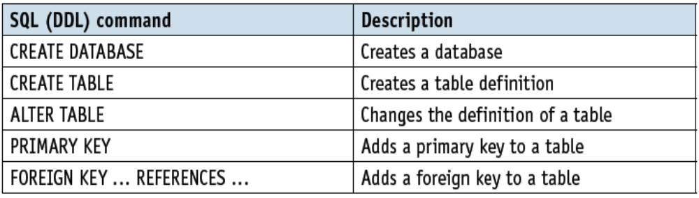
SQL & Data Manipulation
SQL (DDL) commands and scripts
The following DDL commands are some of the commonly used one in SQL scripting.
It is necessary that you understand how these commands are being used.

Slide 6
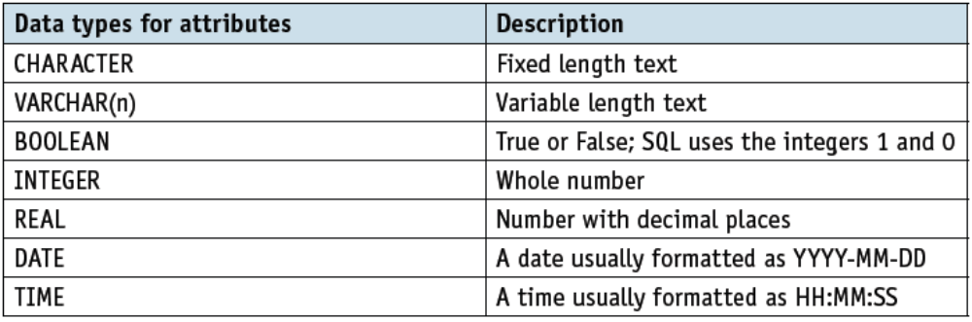
SQL & Data Manipulation
SQL (DDL) commands and scripts
In SQL, there are three main data types: string, numeric, and date and time.
Students would need to be familiar with the following data types used for attributes in SQL.

Slide 7
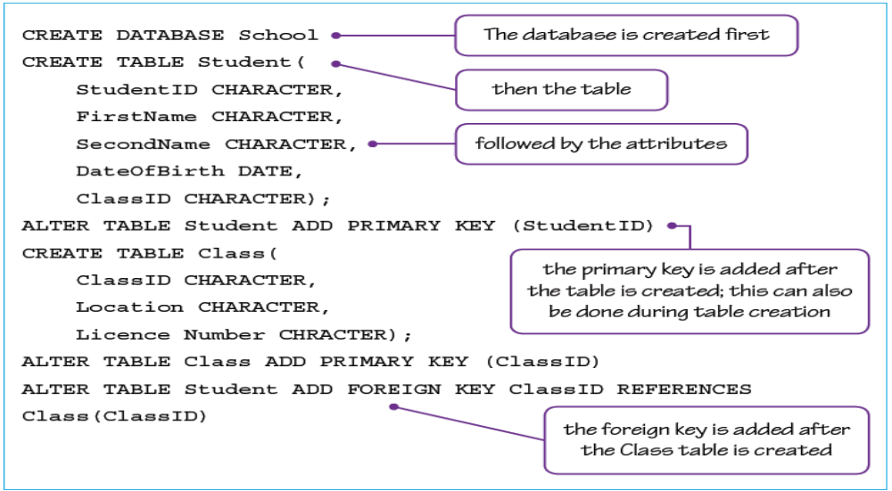
SQL & Data Manipulation
SQL (DDL) commands and scripts
Sample of a DDL (Data Definition Language) in SQL that is used to create the School database..

Slide 8
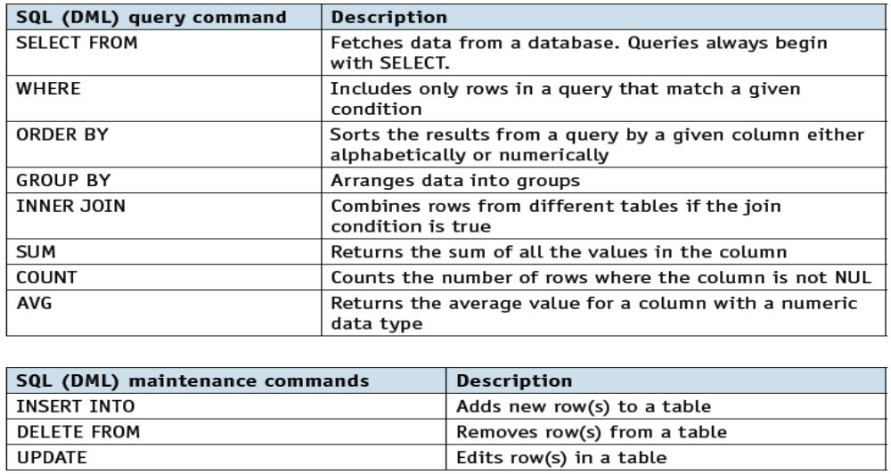
SQL & Data Manipulation
SQL (DML) commands and scripts
A DML (data manipulation language) refers to a computer programming language that allows you to add (insert), delete (delete), and alter (update) data in a database.
Student will need to be able to understand and use the following DML commands.

Slide 9
SQL & Data Manipulation
Examples of DML to Query and Update the Database
This query will show, in alphabetical order of second name, the first and second names of all students in class 7A:
This query will show the teacher’s name and the subject taught:
SELECT FirstName, SecondName
FROM Student
WHERE ClassID = '7A'
ORDER BY SecondName
SELECT Teacher.TeacherName AND Subject.SubjectName
FROM Teacher INNER JOIN Subject ON Teacher.
LicenceNumber = Subject.LicenceNumber

Slide 10
SQL & Data Manipulation
Examples of DML to Query and Update the Database
3. This statement will insert a row into the Student table:
4. These statements will delete the specified row(s) from the Student table
(take care: DELETE FROM Student will delete the whole table!):
5. If an extra column was added to the STUDENTSUBJECT table showing each student’s exam mark in that subject, the following query could be used to total all of the students’ exam marks:
INSERT INTO Student
VALUES(S1301, Peter, Probert, 06/06/2011, 7A)
DELETE FROM Student
WHERE StudentID = 'S1301'
SELECT SUM (ExamMark)
FROM STUDENTSUBJECT

Slide 11
SQL & Data Manipulation
SQL Tutorial: Create Table
Source Code:
CREATE TABLE Persons (
PersonID int,
LastName varchar(255),
FirstName varchar(255),
Address varchar(255),
City varchar(255)
);
Explanation:
The PersonID column is of type int and will hold an integer.
The LastName, FirstName, Address, and City columns are of type varchar and will hold characters, and the maximum length for these fields is 255 characters.
The empty "Persons" table will now look like this:

Slide 12
SQL & Data Manipulation
SQL Tutorial: Drop Table
Syntax:
DROP TABLE table_name;
Example Source Code:
DROP TABLE Student;
Explanation:
The above SQL statement drops the existing table "Student":

Slide 13
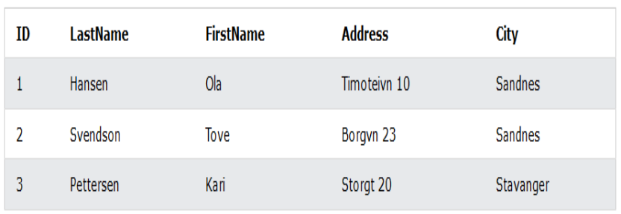
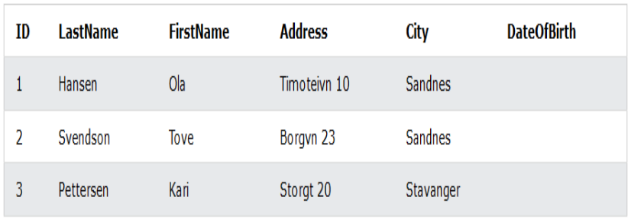
SQL & Data Manipulation
SQL Tutorial: Alter Table
Syntax: Alter Table - Add Column
ALTER TABLE table_name
ADD column_name datatype;
Example Source Code:
ALTER TABLE Persons
ADD DateOfBirth date;
Explanation:
The above SQL statement add a column named "DateOfBirth" in the "Persons" table:
Before Alter Table:
After Alter Table:

Slide 14
SQL & Data Manipulation
SQL Tutorial: Alter Table
Syntax: Alter Table - Modify Column
ALTER TABLE table_name
MODIFY COLUMN column_name datatype;
Example Source Code:
ALTER TABLE Persons
MODIFY COLUMN DateOfBirth year;
Explanation:
"DateOfBirth" column is now of type year and is going to hold a year in a two- or four-digit format.

Slide 15
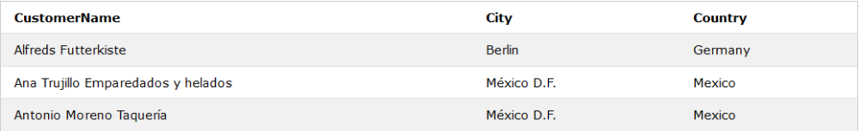
SQL & Data Manipulation
SQL Tutorial: SELECT Statement
Syntax: SELECT Statement on Specific Columns of Table
SELECT column1, column2, ...
FROM table_name;
Syntax: SELECT Statement on ALL Columns of Table
SELECT * FROM table_name;
Example Source Code:
SELECT CustomerName, City, Country FROM Customers;
Explanation:
The above SQL statement selects the "CustomerName", "City", and "Country" columns from the "Customers" table
Customer Table:

Slide 16
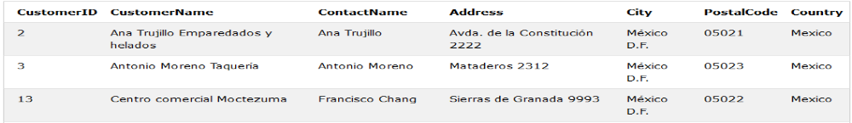
SQL & Data Manipulation
SQL Tutorial: SELECT-WHERE Statement
Syntax:
SELECT column1, column2, ...
FROM table_name
WHERE condition;
Note: The WHERE clause is used to filter records. It is used to extract only those records that fulfill a specified condition.
Example Source Code:
SELECT * FROM Customers
WHERE Country = 'Mexico';
Explanation:
The above SQL statement selects all the customers from "Mexico"
Sample Output from SQL Query:

Slide 17
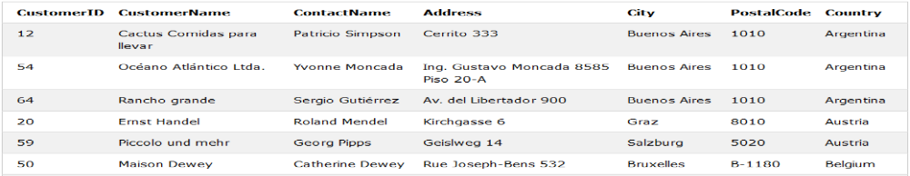
SQL & Data Manipulation
SQL Tutorial: ORDER BY
Syntax:
SELECT column1, column2, ...
FROM table_name
ORDER BY column1, column2, ... ASC|DESC;
Note:The ORDER BY keyword sorts the records in ascending order by default. To sort the records in descending order, use the DESC keyword .
Example Source Code:
SELECT * FROM Customers
ORDER BY Country;
Explanation:
The above SQL statement selects all customers from the "Customers" table, sorted by the "Country" column.

Slide 18
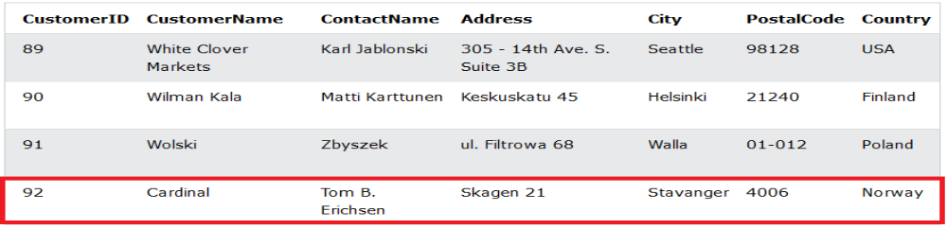
SQL & Data Manipulation
SQL Tutorial: INSERT INTO Statement
Syntax:
INSERT INTO table_name (column1, column2, column3, ...)
VALUES (value1, value2, value3, ...);
Note: Specify both the column names and the values to be inserted into the table.
Example Source Code:
INSERT INTO Customers (CustomerName, ContactName, Address, City, PostalCode, Country)
VALUES ('Cardinal', 'Tom B. Erichsen', 'Skagen 21', 'Stavanger', '4006', 'Norway');
Explanation:
The above SQL statement inserts a new record in the "Customers" table. The selection from the "Customers" table will now look like this:

Slide 19
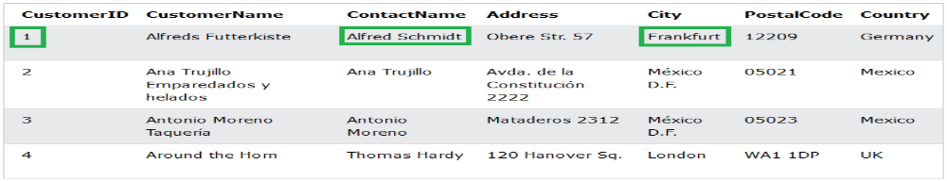
SQL & Data Manipulation
SQL Tutorial: UPDATE Statement
Syntax:
UPDATE table_name
SET column1 = value1, column2 = value2, ...
WHERE condition;
Note: The UPDATE statement is used to modify the existing records in a table.
Example Source Code:
UPDATE Customers
SET ContactName = 'Alfred Schmidt', City = 'Frankfurt'
WHERE CustomerID = 1;
Explanation:
The selection from the "Customers" table will now look like this::

Slide 20
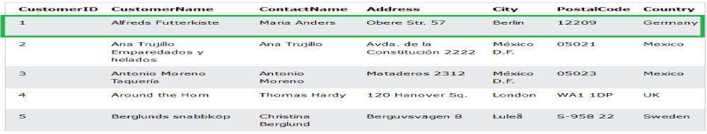
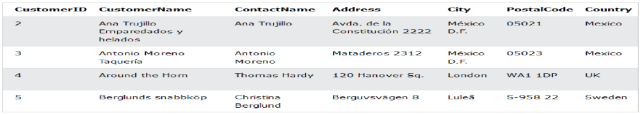
SQL & Data Manipulation
SQL Tutorial: DELETE Statement
Syntax:
DELETE FROM table_name WHERE condition;
Note: Be careful when deleting records in a table! Notice the WHERE clause in the DELETE statement. The WHERE clause specifies which record(s) should be deleted. If you omit the WHERE clause, all records in the table will be deleted!.
Example Source Code:
DELETE FROM Customers WHERE CustomerName='Alfreds Futterkiste';
Before Deletion:
After Deletion:

Slide 21
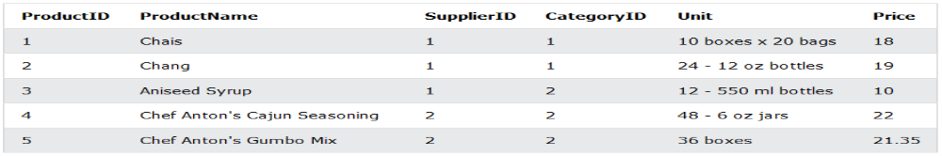
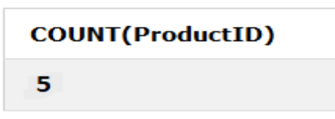
SQL & Data Manipulation
SQL Tutorial: COUNT Function
Syntax:
SELECT COUNT(column_name)
FROM table_name
WHERE condition;
Note: The COUNT() function returns the number of rows that matches a specified criterion.
Example Source Code:
SELECT COUNT(ProductID)
FROM Products;
Product Table (Before Executing SQL Code):
After Executing SQL Code:

Slide 22
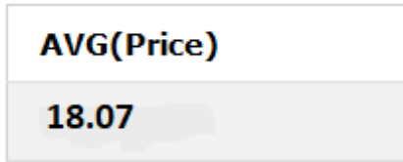
SQL & Data Manipulation
SQL Tutorial: AVG Function
Syntax:
SELECT AVG(column_name)
FROM table_name
WHERE condition;
Note: The AVG() function returns the average value of a numeric column. .
Example Source Code:
SELECT AVG(Price)
FROM Products;
Product Table (Before Executing SQL Code):
After Executing SQL Code:

Slide 23
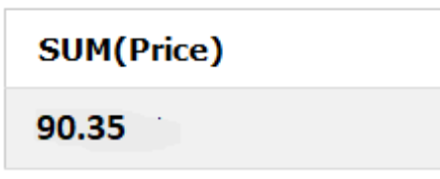
SQL & Data Manipulation
SQL Tutorial: SUM Function
Syntax:
SELECT SUM(column_name)
FROM table_name
WHERE condition;
Note: The SUM() function returns the total sum of a numeric column..
Example Source Code:
SELECT SUM(Price)
FROM Products;
Product Table (Before Executing SQL Code):
After Executing SQL Code:

Slide 24
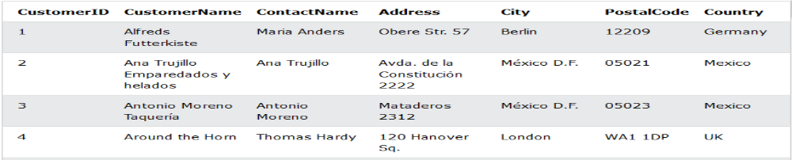
SQL & Data Manipulation
SQL Tutorial: AND Operator
Syntax:
SELECT column1, column2, ...
FROM table_name
WHERE condition1 AND condition2 AND condition3 ...;
Note: The AND operator displays a record if all the conditions separated by AND are TRUE.
Example Source Code:
SELECT * FROM Customers
WHERE ContactName = 'Antonio Moreno' AND Country = 'Mexico';
Customer Table (Before Executing SQL Code):
After Executing SQL Code:

Slide 25
SQL & Data Manipulation
SQL Tutorial: OR Operator
Syntax:
SELECT column1, column2, ...
FROM table_name
WHERE condition1 OR condition2 OR condition3 ...;
Note: The OR operator displays a record if any of the conditions separated by OR is TRUE.
Example Source Code:
SELECT * FROM Customers
WHERE ContactName = 'Antonio Moreno' OR ContactName = 'Thomas Hardy';
Customer Table (Before Executing SQL Code):
After Executing SQL Code:

Slide 26
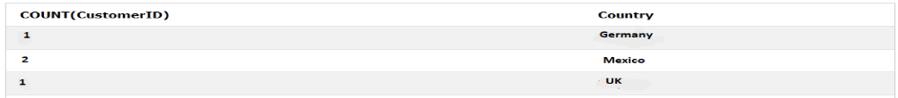
SQL & Data Manipulation
SQL Tutorial: GROUP BY Operator
The GROUP BY statement groups rows that have the same values into summary rows, like "find the number of customers in each country"..
Example Code:
SELECT COUNT(CustomerID), Country
FROM Customers
GROUP BY Country;
Before Executing SQL Code:
After Executing SQL Code:

Slide 27
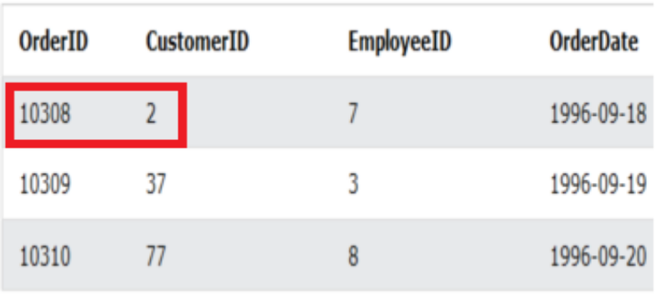
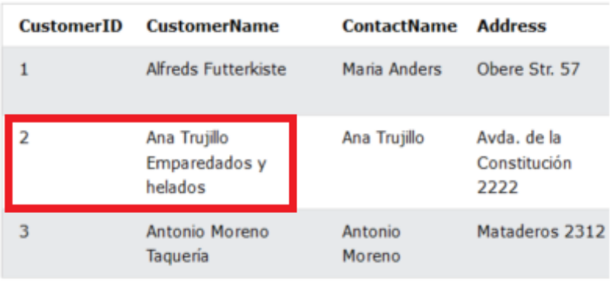
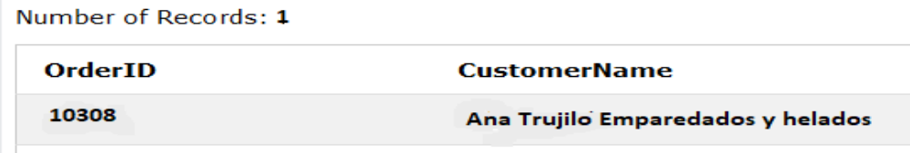
SQL & Data Manipulation
SQL Tutorial: INNER JOIN Keyword
The INNER JOIN keyword selects records that have matching values (intersect) in both tables
Example Code:
SELECT Orders.OrderID, Customers.CustomerName
FROM Orders
INNER JOIN Customers ON Orders.CustomerID = Customers.CustomerID;
After Executing SQL Code:
Orders Table
Customers Table

Slide 28
SQL & Data Manipulation
Class Activity
1) A database design has three tables to store the classes that students attend.
STUDENT(StudentID, FirstName, LastName, Year, TutorGroup)
CLASS(ClassID, Subject)
CLASS-GROUP(StudentID, ClassID)
Primary keys are not shown.
There is a one-to-many relationship between CLASS and CLASS-GROUP.
i) Describe how this relationship is implemented.
ii) Describe the relationship between CLASS-GROUP and STUDENT.
iii) Write an SQL script to display the StudentID and FirstName of all students who are in the tutor group 10B.
iv) Write an SQL script to display the LastName of all students who attend the class whose ClassID is CS1.

